Slide 1
Data Science 100 Lecture 14: Ethics in Data Science
?
Slides by:
Joshua Kroll
kroll@berkeley.edu

Slide 5
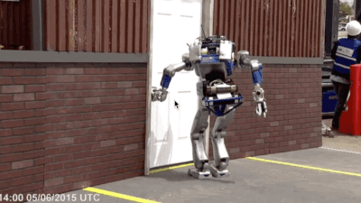
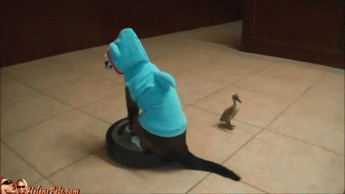
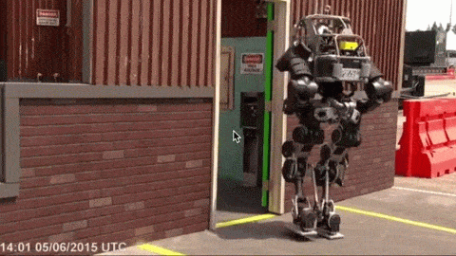

Slide 7
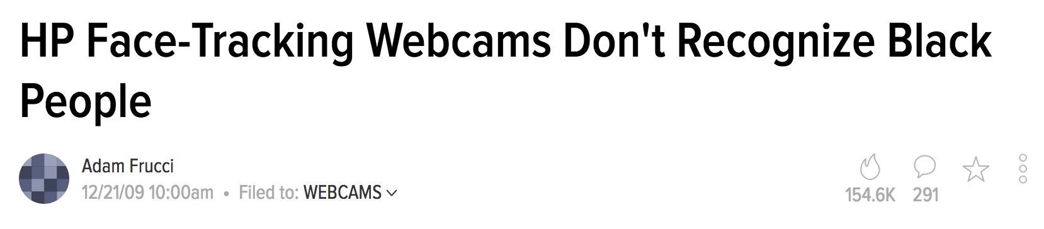

Slide 8
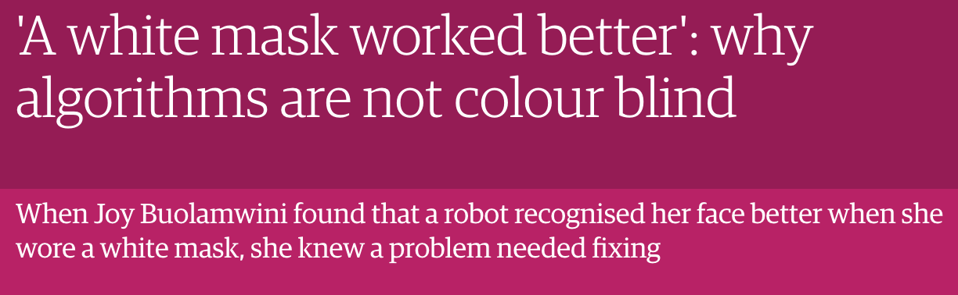

Slide 9
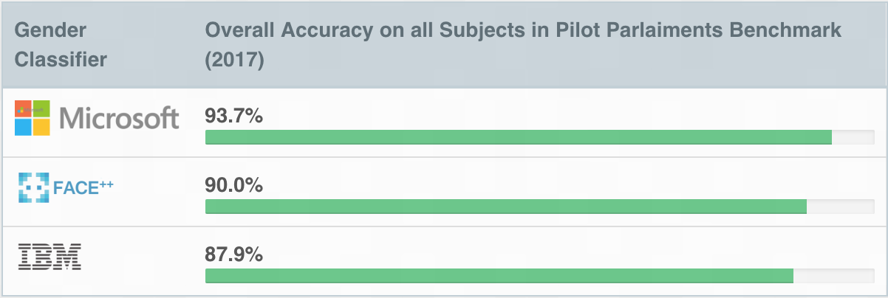
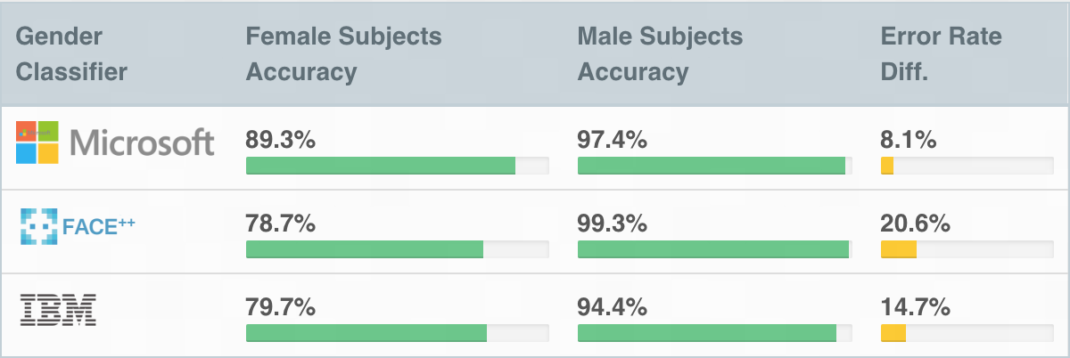
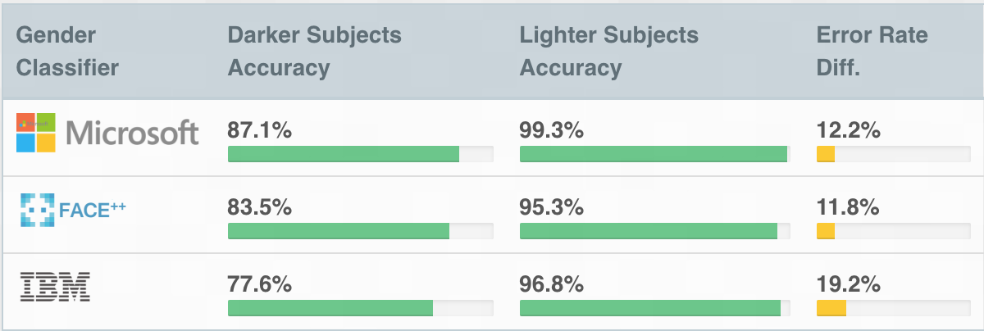
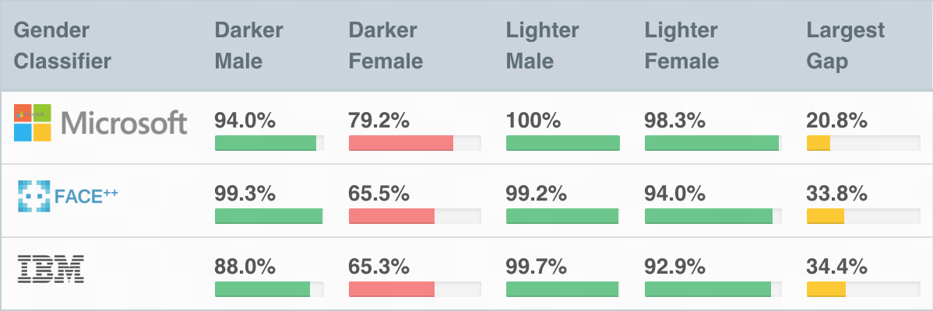
Gender Shades

Slide 10
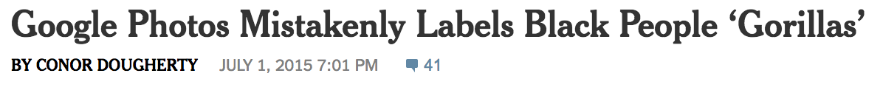

Slide 11
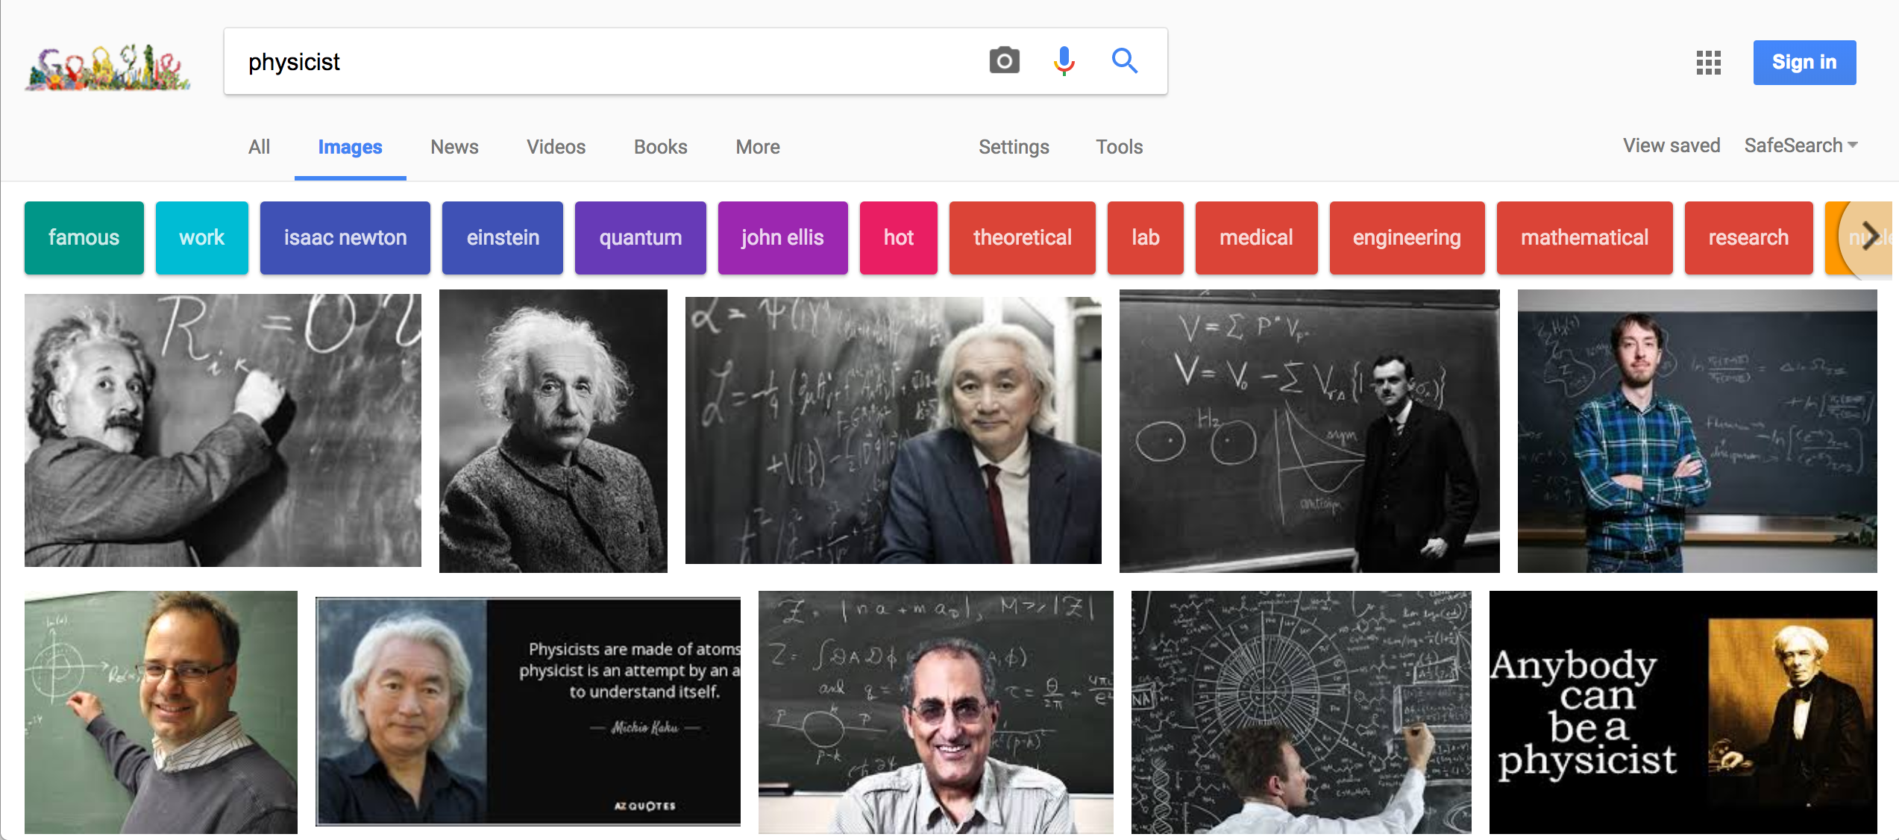

Slide 12
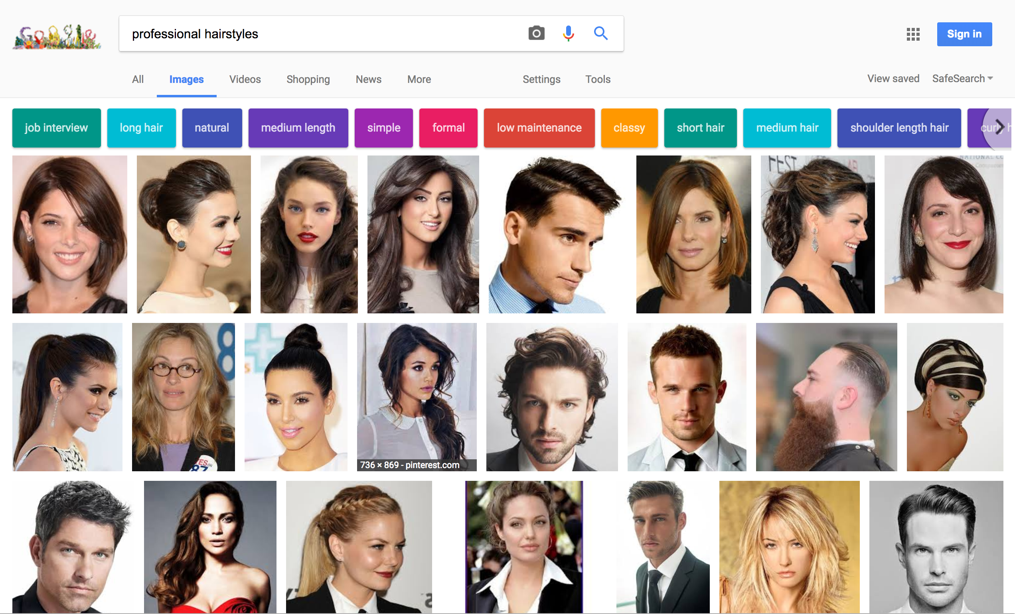

Slide 13

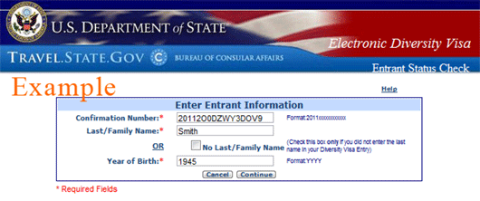






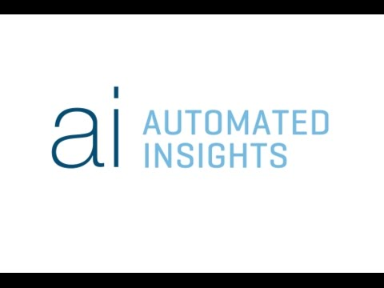






Data science is everywhere…
Criminal Justice
& National Security
Scoring Systems
Lotteries
News
Lending
Hiring

Slide 14
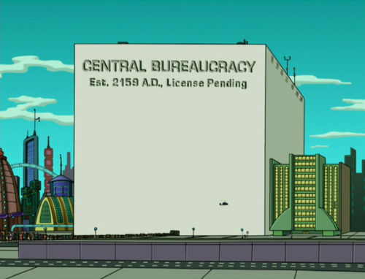

Slide 15
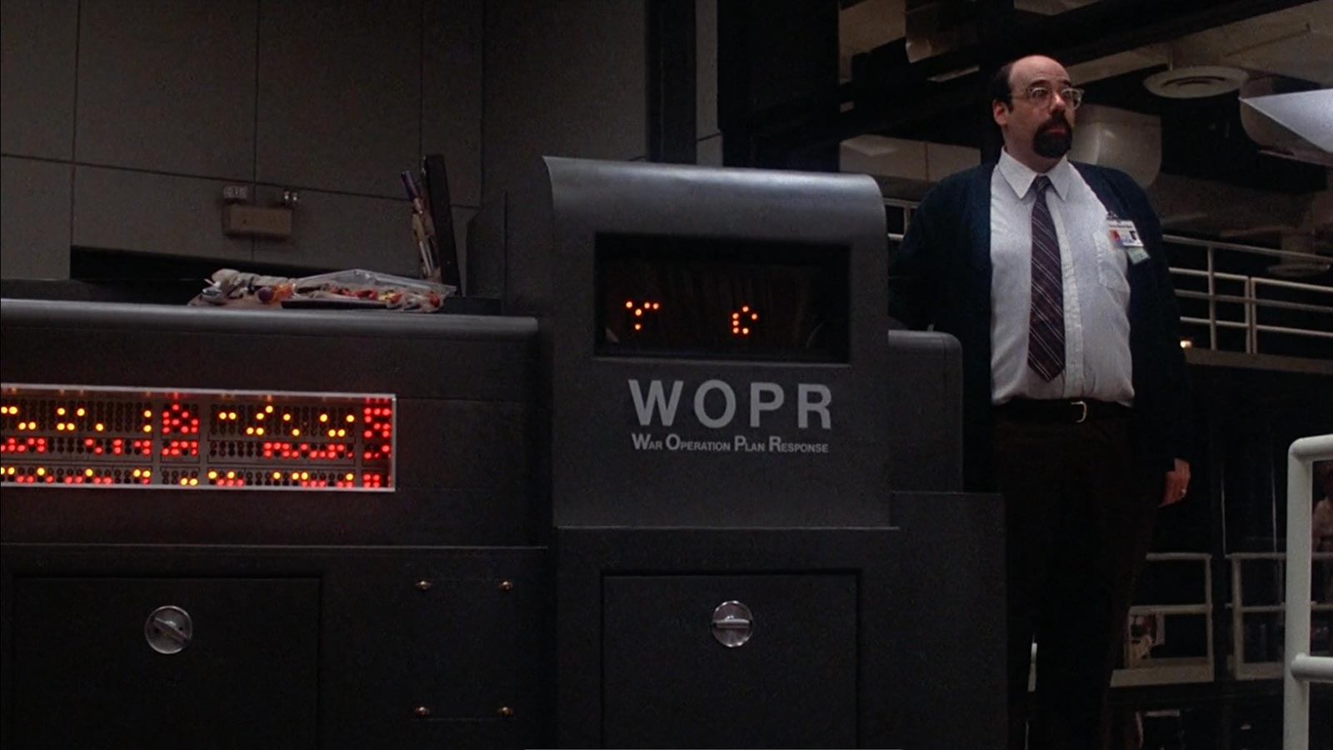

Slide 16
Data Science Life Cycle
Context
Question
Refine Question to an one answerable with data
Design
Data Collection
Data Cleaning
?
BIAS!
Modeling
Test-train split
Loss function choice
Feature engineering
Transformations,
Dummy Variables
Model selection
Best subset regression
Cross-Validation
Model evaluation
Prediction error

Slide 17
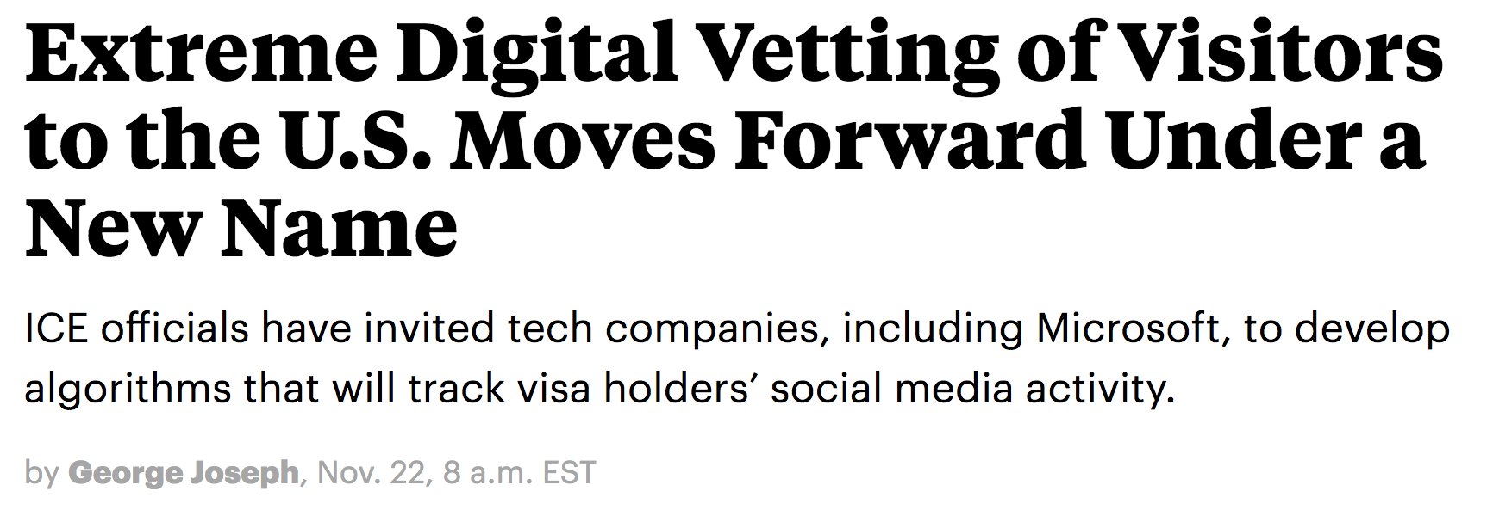
Context & Refinement

Slide 18
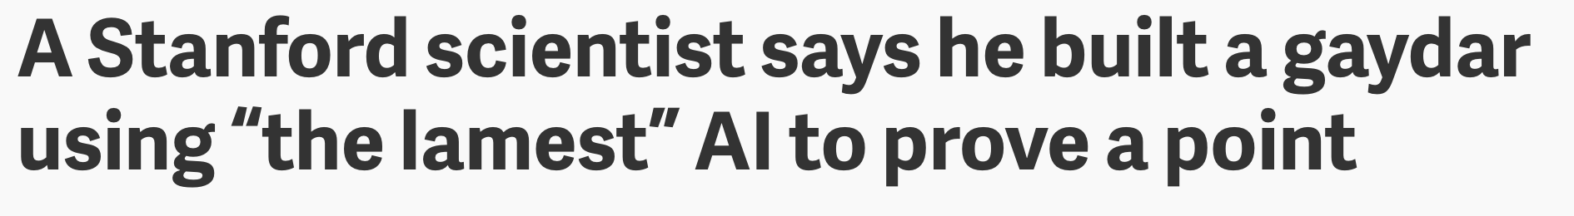
Context & Refinement

Slide 20
Proxies

Slide 21
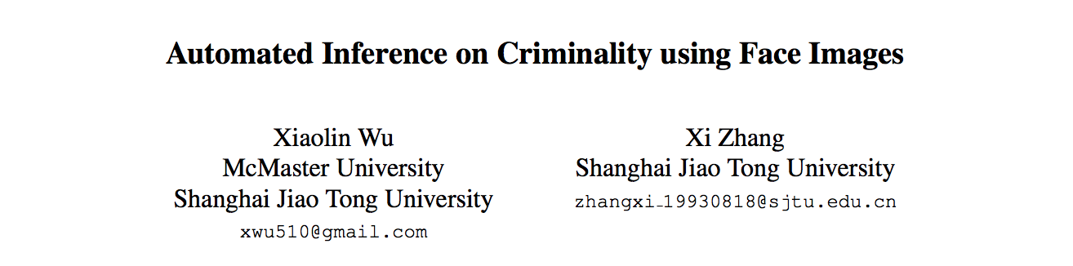

Slide 22
Data Collection

Slide 23
Data Collection

Slide 24
http://bit.ly/ds100-fa18-dsm2

Slide 25
From Lum, Kristian, and William Isaac. "To predict and serve?." Significance 13, no. 5 (2016): 14-19.

Slide 26
Data Cleaning

Slide 27
Data Cleaning

Slide 28
Data Cleaning

Slide 29
Test-Train Split

Slide 30
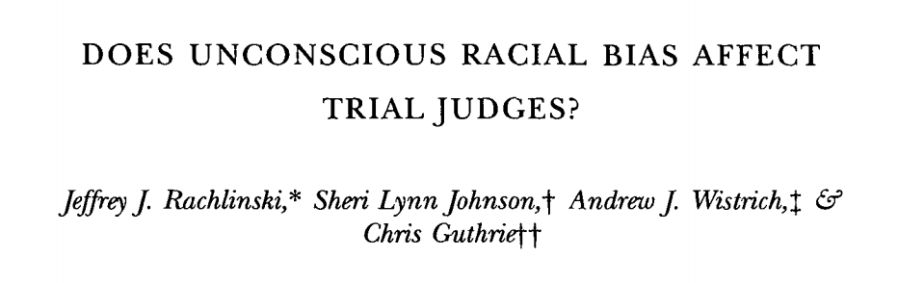
Loss Function Choice

Slide 31
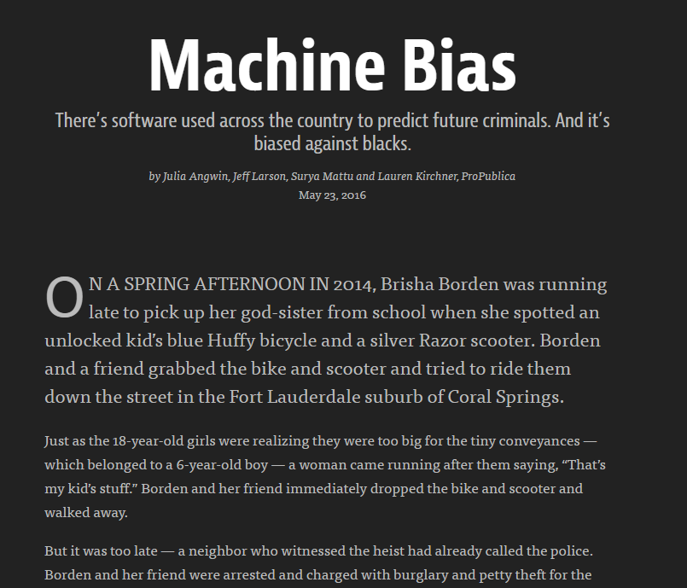

Slide 35
So why does ProPublica think COMPAS is biased?

Slide 37
Feature Engineering

Slide 38
Feature Engineering

Slide 39
Feature Engineering

Slide 40
Model Selection

Slide 41
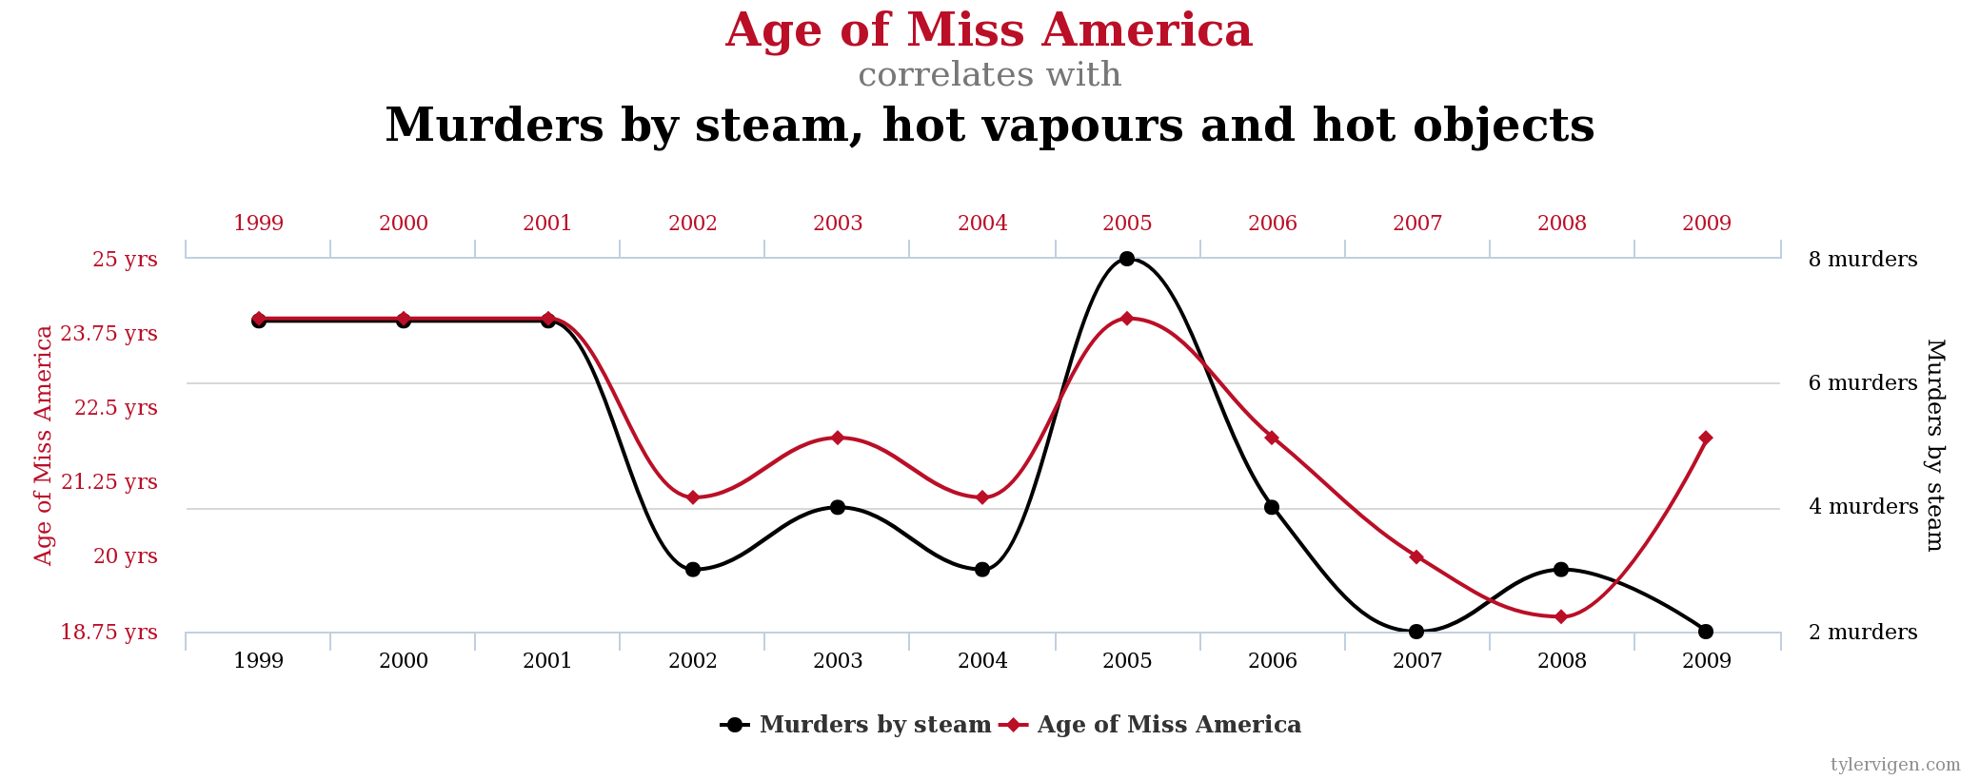
Model Evaluation

Slide 42
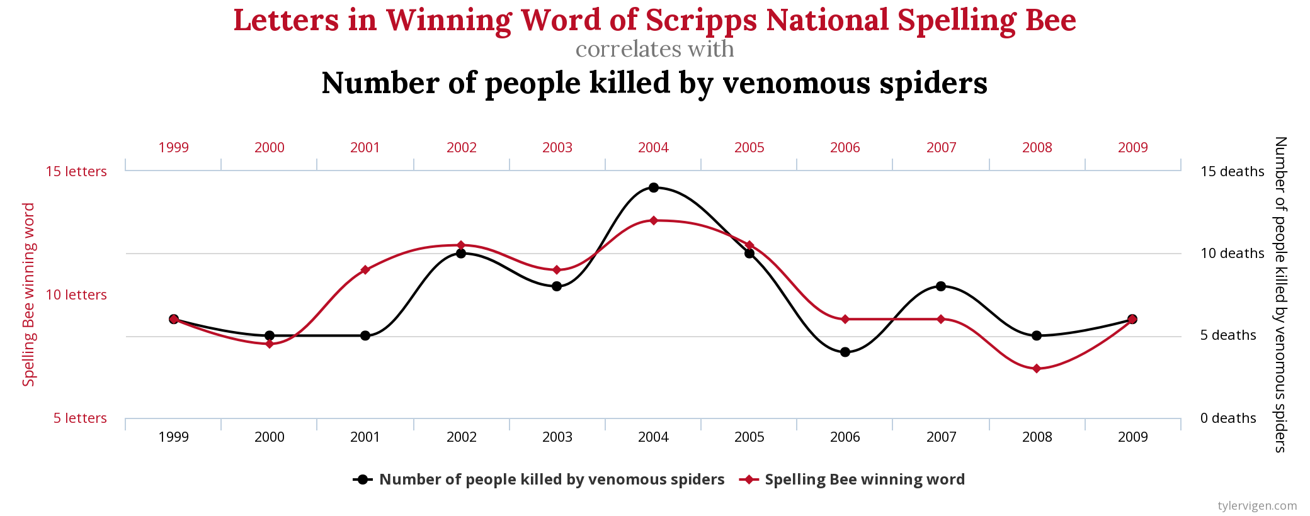
Model Evaluation

Slide 43
So what do we do about this?

Slide 44
Ethical Lessons
Know what the data are telling you
Understand your model, and validate it
Involve domain experts; “raw data” is an oxymoron
Communicate not just model capabilities, but also limits and assumptions
Data about people are about people
The data do not exist on their own, someone made them
Always consider why your model might be wrong in systematic ways
Don’t just trust the technology, make it trustworthy
Close the data science lifecycle: the world changes, and so should your models

Slide 45
Ethics beyond the Data Science Lifecycle

Slide 46
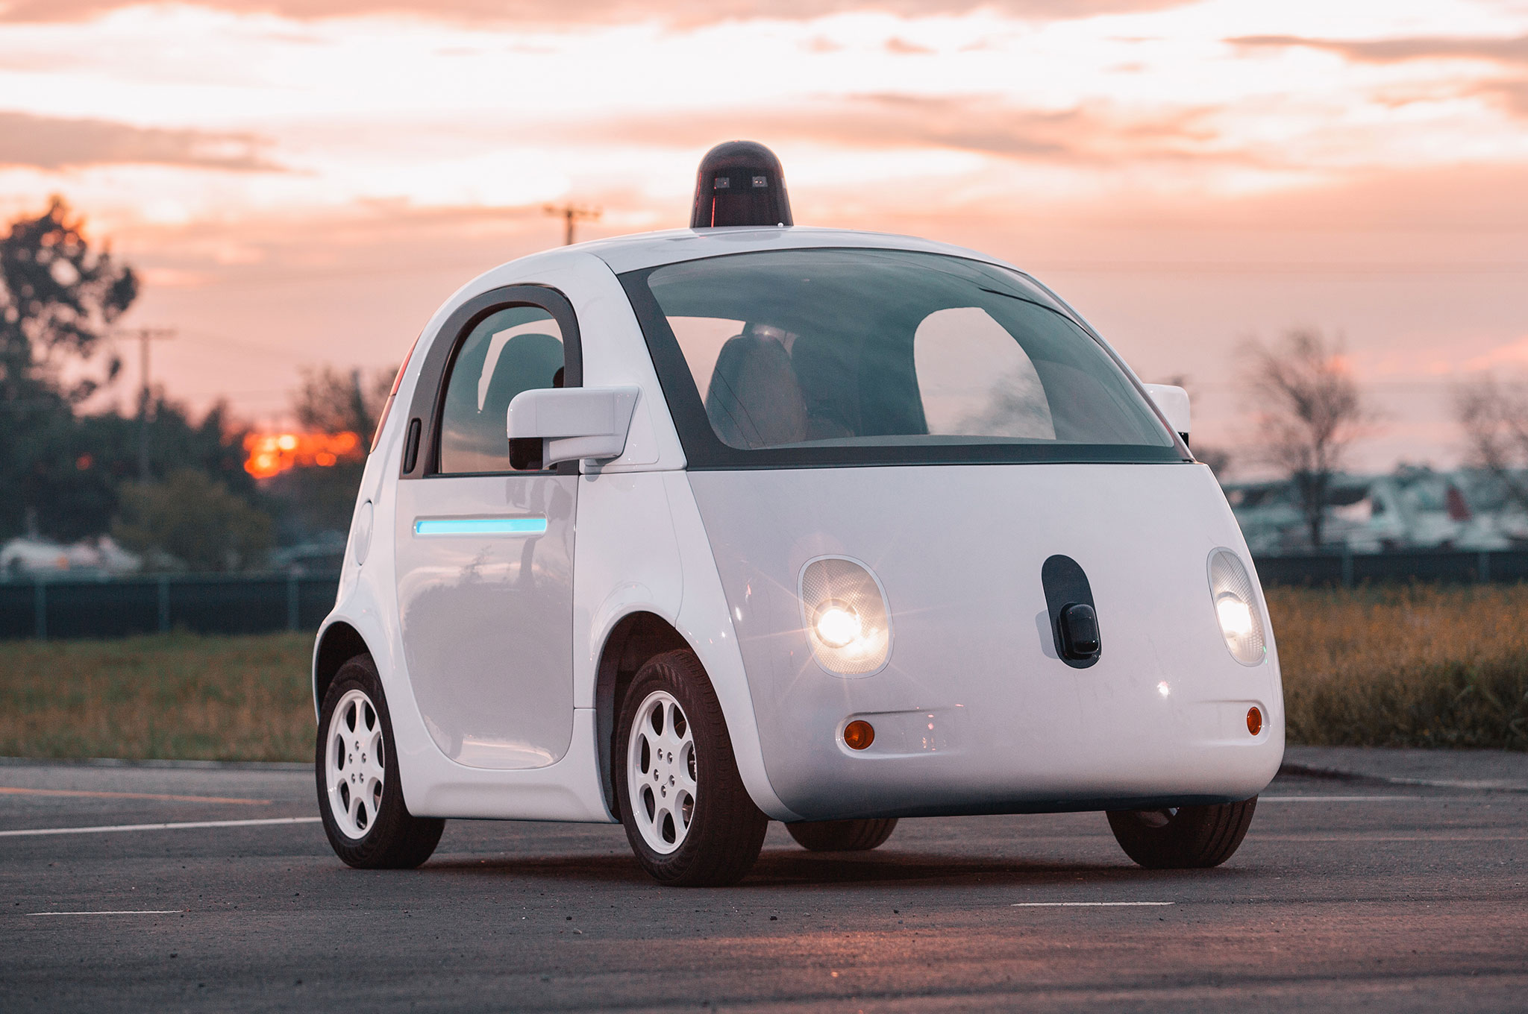
Should we deploy technology at all?

Slide 47

When is it ethical to collect data?

Slide 48
When is it ethical to collect sensitive data?
Without knowing sensitive attributes, it’s not possible to know how to make good decisions.
E.g., in a credit-granting context, there’s no reason to believe that qualified minority applicants will be similar to qualified members of the majority
But having sensitive data means it can be repurposed for other uses

Slide 49
Inclusion and Representation
Notes:
Inclusion issues

Slide 50
Resources
Take a course at Berkeley on people and technology
Visit https://fatml.org and https://fatconference.org
Reading list
Principles for Accountable Algorithms
Books
Weapons of Math Destruction, by Cathy O’Neil
How to Lie With Statistics, by Darrell Huff
Courses around the world: tinyurl.com/ethics-classes

Slide 51
“Remember that all models are wrong; the practical question is how wrong do they have to be to not be useful.”
-George E. P. Box

